Slide 1

Call for User Stories and Case Studies
User + Developer Monthly Meetup
2024/11/20

Slide 2
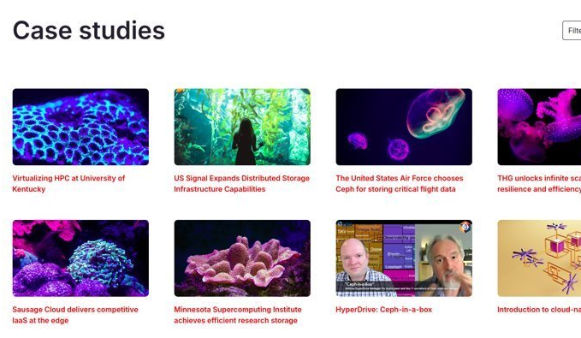
Introducing a New Focus on User Stories
Goal
Build a repository of Ceph use cases and success stories
Showcase innovative use cases
How
Distribute a survey to the user community to collect case studies
Feature stories on the Ceph website
Highlight impactful, large-scale production environments
https://ceph.io/en/discover/case-studies/

Slide 3

Motivation
Why collect user stories and case studies?
Encourages collaboration in the user community
Exposes new innovations and use cases as Ceph continues to grow
Enriches collective knowledge base

Slide 4
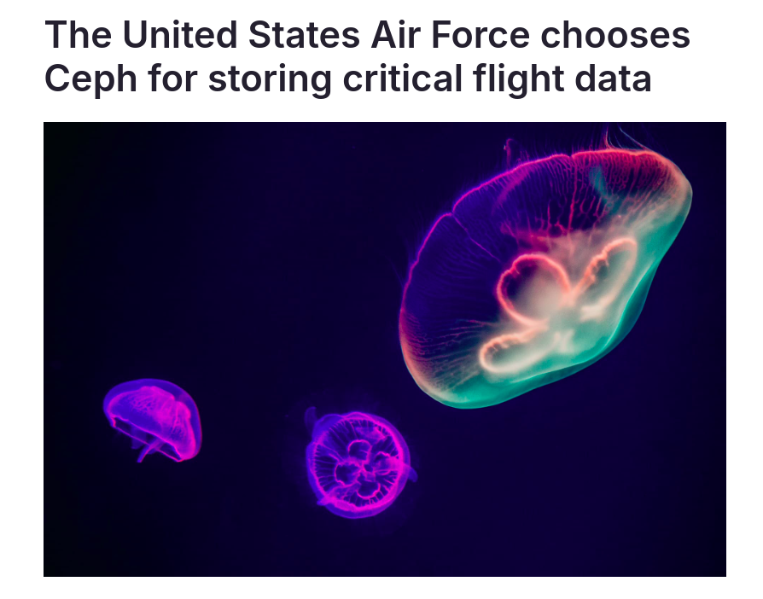
What We're Looking For
Large-scale production clusters
Details to include:
Overview of the organization
Use case for Ceph (i.e. type of data, environment)
Challenges and how Ceph helped overcome them
Benefits and results (i.e. performance, scalability, reliability)
Details beyond application layer
https://ceph.io/en/discover/case-studies/us-airforce-flight-data/

Slide 5
Next Steps
We’ll soon release a survey to gather stories
To prepare:
Think about your Ceph use case
Identify key challenges and successes

Slide 6
Questions?

